Slide 1
Witness tests at CBTL during IQA in 2018
November 2, 2018 V 2.0
For questions or comments on the content, please contact Michael J. Howell, Kyle Huang or Denise Echols

Slide 2
Agenda
Background
General
Witness Test under IEC 60950-1
Witness Test under IEC 62133-1
Witness Test under IEC 60601-1
Witness Test under IEC 60335-1
Records of Audit (lab assessment form example)

Slide 3
Background
Lab test capability is part of an IECEE CBTL Assessment. Some CARs generated from IECEE CBTL assessments focused on lab test capability, specifically equipment, critical consumables, or test methods not in compliance with the IEC standard requirements.
Though some UL standards for final products have been harmonized with IEC standards, they still have differences in small details, due to the structure of IEC standards, CTL Decision Sheets published by IECEE CB Scheme, IEC TC Interpretation Sheets and the traditional approach of UL that includes the use of Certification Requirement Decisions and PAGs developed by UL PDE’s.
Note: IEC TC Interpretation Sheets: http://decisions.iecee.org/iecee/SearchCMC.nsf/home?OpenForm&Start=1&Count=30&Expand=3&Seq=5

Slide 4
General
Following tests are selected by CB program owner for witness of test in 2018.
1) Test under IEC 60950-1
a. Steady force tests
2) Test under IEC 62133-1
a. Crushing test
3) Tests under IEC 60601-1
a. Transformer overload test
4) Tests under IEC 60335-1
a. Annex N proof tracking tests
If a CBTL has capability in several above categories, all tests applicable need to be witnessed. Note: If Tracking test was witnessed in 2017, Proof Tracking Test is not required to be witnessed.

Slide 5
General
Corporate Internal Quality Audits will focus on lab testing capability during on-site audits of UL labs based on their existing CBTL scopes.
A group of tests selected will be reviewed by IQA auditors. Nonconformance will be documented in the GCAR Database. The list of tests assessed will be included in the audit records.
The corrective action will be handled according to the Global Corrective Action Procedure. If a systemic issue is found, the corrective action may be escalated for effective resolution across UL.
Corporate Quality Manager will maintain a list of tests selected in an ongoing CBTL Audit Plan. There is no intent to cover every test in every standard. However, assessments will cover various types of testing activities under CBTL scopes in a period of time obtained from program management and NCB inputs.

Slide 6
General
The list of tests need to be included in Attachment A of the Scope letter and communicated to local contact before the audit so the site can arrange the resource for the audit.

Slide 7
1) Steady force tests
IEC 60950-1: 2005 +A1:2009+A2:2013, Clauses 4.2.1 – 4.2.4
CTL Equipment list:
http://www.iecee.org/get_fileID.php?file_id=181071
Test Ambient Conditions:
The standard does not specify test ambient conditions.

Slide 8
1) Steady force tests
Test Methods:
4.2.2 Steady force test, 10 N
Components and parts, other than parts serving as an ENCLOSURE (see 4.2.3 and 4.2.4), are subjected to a steady force of 10 N ± 1 N.
Compliance criteria are in 4.2.1.
(see slides 11 and 12 for 4.2.1 compliance criteria)

Slide 9
1) Steady force tests
Test Methods (cont.):
4.2.3 Steady force test, 30 N
Parts of an ENCLOSURE located in an OPERATOR ACCESS AREA, which are protected by a cover or door meeting the requirements of 4.2.4, are subjected to a steady force of 30 N ± 3 N for a period of 5 s, applied by means of a straight unjointed version of the test finger, Figure 2A
(see 2.1.1.1), to the part on or within the equipment.
Compliance criteria are in 4.2.1.
(see slides 11 and 12 for 4.2.1 compliance criteria)
(see slides 14 and 15 for test finger details)

Slide 10
1) Steady force tests
Test Methods (cont.):
4.2.4 Steady force test, 250 N
External ENCLOSURES are subjected to a steady force of 250 N ± 10 N for a period of 5 s, applied in turn to the top, bottom and sides of the ENCLOSURE fitted to the equipment, by means of a suitable test tool providing contact over a circular plane surface 30 mm in diameter. However, this test is not applied to the bottom of an ENCLOSURE of equipment having a mass of more than 18 kg.
Compliance criteria are in 4.2.1.
(see slides 11 and 12 for 4.2.1 compliance criteria)

Slide 11
1) Steady force tests
Compliance criteria in 4.2.1:
Compliance is checked by inspection of the construction and available data and, where necessary, by the relevant tests of 4.2.2 to 4.2.7 as specified.
The tests are not applied to handles, levers, knobs, the face of cathode ray tubes (see 4.2.8) or to transparent or translucent covers of indicating or measuring devices, unless parts at HAZARDOUS VOLTAGE are accessible by means of the test finger, Figure 2A (see 2.1.1.1), if the handle, lever, knob or cover is removed.
During the tests of 4.2.2, 4.2.3 and 4.2.4, earthed or unearthed conductive ENCLOSURES shall not bridge parts between which a HAZARDOUS ENERGY LEVEL exists and shall not contact a bare part at HAZARDOUS VOLTAGE. For voltages exceeding 1 000 V a.c. or 1 500 V d.c., contact is not permitted and there shall be an air gap between the part at HAZARDOUS VOLTAGE and the ENCLOSURE. This air gap shall either have a minimum length equal to the minimum CLEARANCE specified in 2.10.3 (or Annex G) for BASIC INSULATION or withstand the relevant electric strength test in 5.2.2.

Slide 12
1) Steady force tests
Compliance criteria in 4.2.1 ( Continued) :
After the tests of 4.2.2 to 4.2.7, the sample shall continue to comply with the requirements of 2.1.1, 2.6.1, 2.10, 3.2.6 and 4.4.1. It shall show no signs of interference with the operation of safety features such as THERMAL CUT-OUTS, overcurrent protection devices or interlocks. In case of doubt, SUPPLEMENTARY INSULATION or REINFORCED INSULATION is subjected to an electric strength test as specified in 5.2.2.
Damage to finish, cracks, dents and chips are disregarded if they do not adversely affect safety.

Slide 13
1) Steady force tests
Some Definitions:
1.2.8.6 HAZARDOUS VOLTAGE: voltage exceeding 42,4 V peak, or 60 V d.c., existing in a circuit that does not meet the requirements for either a LIMITED CURRENT CIRCUIT or a TNV CIRCUIT
1.2.8.10 HAZARDOUS ENERGY LEVEL: available power level of 240 VA or more, having a duration of 60 s or more, or a stored energy level of 20 J or more (for example, from one or more capacitors), at a potential of 2 V or more
1.2.7.1 OPERATOR ACCESS AREA: part of the equipment to which, under normal operating conditions, one of the following applies:
  - access can be gained without the use of a TOOL;
  - the means of access is deliberately provided to the OPERATOR;
  - the OPERATOR is instructed to enter regardless of whether or not a TOOL is needed to gain access
  The terms "access" and "accessible", unless qualified, relate to OPERATOR ACCESS AREA as defined above.

Slide 14
1) Steady force tests
Some Definitions (cont.):
1.2.9.2 BASIC INSULATION: insulation to provide basic protection against electric shock
1.2.9.3 SUPPLEMENTARY INSULATION: independent insulation applied in addition to BASIC INSULATION in order to reduce the risk of electric shock in the event of a failure of the BASIC INSULATION
1.2.9.4 DOUBLE INSULATION: insulation comprising both BASIC INSULATION and SUPPLEMENTARY INSULATION
1.2.9.5 REINFORCED INSULATION: single insulation system that provides a degree of protection against electric shock equivalent to DOUBLE INSULATION under the conditions specified in this standard
1.2.10.1 CLEARANCE: shortest distance between two conductive parts, or between a conductive part and the BOUNDING SURFACE of the equipment, measured through air

Slide 15
1) Steady force tests
Equipment:
Check the calibration records:
  Unjointed test finger ( See next pages 13 and 14 )
  Force gauge (± 6% )
  Timer (1 s and above: ± 1% )
  Calipers (up to 1 mm: ± 0,05 mm; 1 mm up to 25 mm: ± 0,1 mm; 25 mm and above: ± 0,5%)
  Scale (+/- 1%)
B. Check calibration or validation records:
1) Circular plane ( 30 mm diameter, ± 1,5 mm)

Slide 16
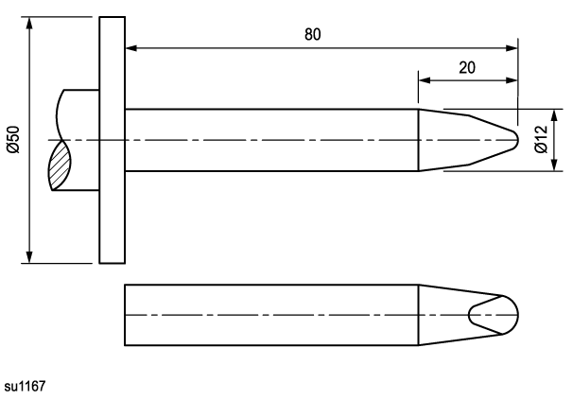
1) Steady force tests
Straight unjointed version of the test finger, Figure 2A

Slide 17
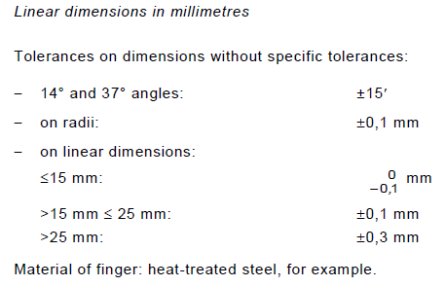
1) Steady force tests
Straight unjointed version of the test finger, Figure 2A (cont.)

Slide 18
2) Crushing test
2) Crushing test
IEC 62133-1:2017, Clause 7.3.6
CTL Equipment list:
https://www.iecee.org/get_fileID.php?file_id=167605
Standard Scope:
“Portable sealed secondary nickel cells and batteries containing alkaline electrolyte”

Slide 19
2) Crushing test
7.3.6 Crushing of cells
b) Test
Each fully charged cell is crushed between two flat surfaces. The force for the crushing is applied by a device exerting a force of 13 kN ± 0,78 kN. The crushing is performed in a manner that will cause the most adverse result. Once the maximum force has been applied, or an abrupt voltage drop of one-third of the original voltage has been obtained, the force is released.
A cylindrical or prismatic cell is crushed with its longitudinal axis parallel to the flat surfaces of the crushing apparatus. To test both wide and narrow sides of prismatic cells, a second set of cells is tested, rotated 90°around their longitudinal axes compared to the first set.
c) Acceptance criteria
No fire, no explosion.

Slide 20
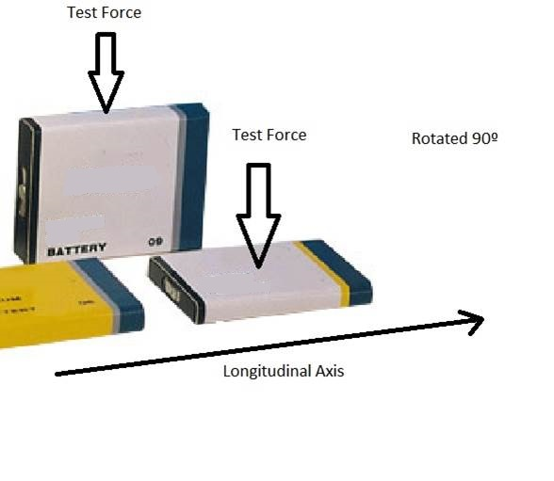
2) Crushing test
Test arrangement example for prismatic cells

Slide 21
2) Crushing test
Note - For those labs which only have the previous version standard IEC 62133 in their scope instead of the current IEC 62133-1, the same test method is used except the test force is 13 kN ± 1 kN
Equipment:
Check the calibration records:
Force Gage ( +/- 6% )
Voltage Meter ( +/- 1.5% )

Slide 22
3) Transformer overload
3) Transformer overload test
IEC 60601-1:2005+A1:2012, Clause 15.5.1.3
CTL Equipment list:
https://www.iecee.org/get_fileID.php?file_id=172543
Test Ambient Conditions:
The standard does not specify test ambient conditions, but indicates that tests are performed within the range of environmental conditions indicated in the technical description (users manual, etc). Ambient temperature, humidity and atmospheric pressure should be monitored and recorded during the test.

Slide 23
3) Transformer overload test
15.5.1 Overheating
15.5.1.1 * Transformers
Transformers of ME EQUIPMENT shall be protected against overheating in the event of short
circuit or overload of any output winding.
Compliance is checked by the tests of 15.5.1.2 and 15.5.1.3 as appropriate under the
following conditions.
Each winding is tested, in turn, with the following parameters at the most adverse value:
– primary voltage maintained between 90 % to 110 % of RATED voltage
– RATED input frequency
– loads on other windings between no load and their NORMAL USE load
Short circuit or resistive load, as appropriate, is applied at the ends of the windings or at the first point that can be short circuited under SINGLE FAULT CONDITION.
Components intended to prevent overheating of the transformer during short circuit and Overload conditions are included as part of the tests of 15.5.1.2 and 15.5.1.3 provided that:
– the component is one with high-integrity characteristics, and
– two MEANS OF OPERATOR PROTECTION are provided between the output contacts of the transformer up to the COMPONENT WITH HIGH-INTEGRITY CHARACTERISTICS.
(for example, external fuses, circuit breakers, thermal cut-outs, etc., provided on the primary side of the transformer)

Slide 24
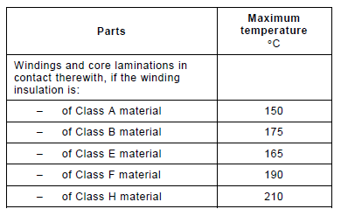
3) Transformer overload test
During the tests, no winding are to open, no HAZARDOUS SITUATION occurs, and the maximum
temperatures of windings are not to exceed the values in Table 31. After the short circuit and
overload tests, the transformer is to pass the dielectric strength test (as described in 8.8.3)
between primary and secondary windings, between the primary windings and the frame and
between the secondary windings and the frame. The tests are performed under the conditions
specified in 11.1, either in the ME EQUIPMENT or under simulated conditions on the bench.
Table 31 – Maximum allowable temperatures of transformer windings under overload
and short-circuit conditions at 25 °C (± 5 °C) ambient temperature

Slide 25
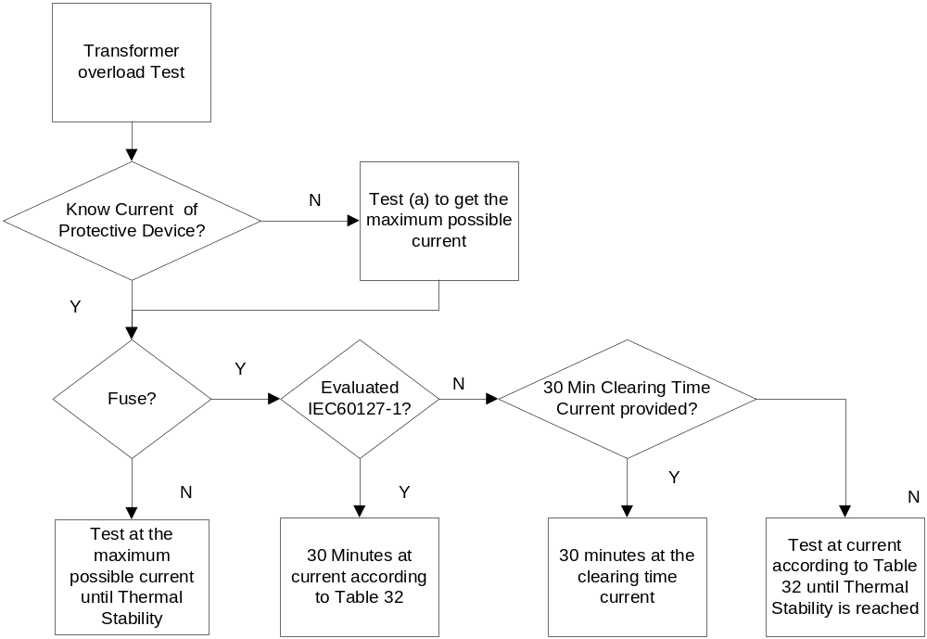
3) Transformer overload test

Slide 26
3) Transformer overload test
15.5.1.3 Overload test
Windings with more than one protective device could require multiple overload tests in order
to fully evaluate worst-case NORMAL USE loading and fusing.
The overload test may be applied after rectification.
a) This test (a) is performed if the current at which the protective device operates cannot be
determined based on a review of the provided protective devices and their performance
data; otherwise test b) is performed.
The winding under test is loaded to its NORMAL USE load until THERMAL STABILITY is reached.
The load is then progressively adjusted in appropriate steps to approach the minimum
current at which the protective device operates. Each adjustment of the load is followed by
a sufficient time to reach THERMAL STABILITY, and the load current and temperature are to
be noted.
Following operation of a protective device, b) is performed.

Slide 27
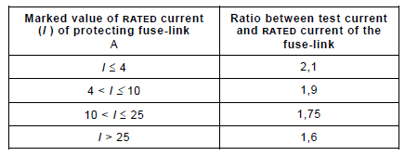
3) Transformer overload test
b) If the protective device that operated in a) is external to the transformer, it is shunted. The winding under test is loaded based on the type of protective device as follows.
– Fuse in accordance with IEC 60127-1:
30 min at the appropriate test current determined from Table 32.
Table 32 – Test current for transformers

Slide 28
3) Transformer overload test
– Fuses not in accordance with IEC 60127-1:
30 min at the current according to the characteristics supplied by the fuse
manufacturer, specifically the 30 min clearing-time current. If no 30 min clearing-time
current data is available, the test current from Table 32 is used until THERMAL STABILITY is achieved.
– Other protective device:
until THERMAL STABILITY at a current just below that which caused the device to operate in a).
This portion of the overload test is concluded at the specified time or when a second
protective device opens.
Clause 3.125
THERMAL STABILITY
condition under which the temperature of an object does not increase by more than 2 °C over a period of 1 h

Slide 29
3) Transformer overload test
Equipment:
A. Check the calibration records:
1) Resistance Meter for Transformer Winding ( 1 m Ohm up to 100 m Ohm +/- 5%, 100 m Ohm to 100 k Ohm ± 3% )
2) Voltage Meter ( +/- 1.5%)
3) Current Meter ( <= 5A: 1.5%; >5 A: 2.5%)
4) Timer ( 1 s and above: ± 1% )
5) Temperature indicator recorder ( - 35°C to below 100°C: ± 2°C;
100°C up to 500° C: ± 3% , not including thermocouples )
6) Ambient Temperature Indicator ( +/- 2 degree C)
7) Ambient Humidity Meter (+/- 6%)
8) Barometer ( +/- 10 kPa) – Other means of measurement are allowed, if the traceability to national calibration standards is provided.
B. Check calibration or validation records:
Thermocouple
C. No validation/ calibration required:
1) Resistive Load

Slide 30
4) Annex N proof tracking test
IEC 60335-1:2010+AMD1:2013 +AMD2:2016, Annex N
CTL Equipment list:
https://www.iecee.org/get_fileID.php?file_id=173009
https://www.youtube.com/watch?v=15Qm4K_G4Sg

Slide 31
4) Annex N proof tracking test
From IEC 60335-1:2010+AMD1:2013 +AMD2:2016, Clause 29.2:
The relationship between the material group and the comparative tracking index (CTI) values,
as given in Subclause 4.8.1.3 of IEC 60664-1, is as follows:
– material group I: 600 ≤ CTI;
– material group II: 400 ≤ CTI < 600;
– material group IIIa: 175 ≤ CTI < 400;
– material group IIIb: 100 ≤ CTI < 175.
These CTI values are obtained in accordance with IEC 60112 using solution A. If the CTI value of the material is unknown, a proof tracking index (PTI) test in accordance with Annex N is carried out at the CTI values specified, in order to establish the material group.
NOTE 4 The test for comparative tracking index (CTI) in accordance with IEC 60112 is designed to compare the performance of various insulating materials under test conditions, namely drops of an aqueous contaminant falling on a horizontal surface leading to electrolytic conduction. It gives a qualitative comparison but in the case of insulating materials having a tendency to form tracks, it can also give a quantitative comparison, namely the comparative tracking index.

Slide 32
4) Annex N proof tracking test
IEC 60335-1:2010+AMD1:2013 +AMD2:2016
Annex N
(normative)
Proof tracking test
The proof tracking test is carried out in accordance with IEC 60112 with the following modifications.
7 Test apparatus
7.3 Test solutions
Test solution A is used.
10 Determination of proof tracking index (PTI)
10.1 Procedure
Modification:
The proof voltage is 100 V, 175 V, 400 V or 600 V, as appropriate.
The test is carried out on five specimens.
In case of doubt, a material is considered to have a PTI of the specified value if it withstands the test at a voltage equal to the proof voltage reduced by 25 V, the number of drops being increased to 100.
10.2 Report
Addition:
The report shall state if the PTI value was based on a test using 100 drops with a test voltage
of (PTI-25) V.

Slide 33
4) Annex N proof tracking test
IEC 60112:2003 + A1:2009
5 Test specimen
Any approximately flat surface may be used, provided that the area is sufficient to ensure that during the test no liquid flows over the edges of the test specimen.
NOTE 1 Flat surfaces of not less than 20 mm × 20 mm are recommended to reduce the probability of electrolyte loss over the specimen edge although smaller sizes may be used, subject to no electrolyte loss, e.g. ISO 3167, 15 mm × 15 mm multi-purpose test specimens.
NOTE 2 It is preferable to use separate test specimens for each test. If several tests are to be made on the same test piece, care should be taken to ensure that the testing points are sufficiently far from each other so that splashes or fumes from the testing point will not contaminate the other areas to be tested.
The thickness of the test specimen shall be 3 mm or more. Individual pieces of material may be stacked to obtain the required thickness of at least 3 mm.

Slide 34
4) Annex N proof tracking test
Test specimens shall have nominally smooth and untextured surfaces which are free from surface imperfections such as scratches, blemishes, impurities, etc, unless otherwise stated in the product standard. If this is impossible, the results shall be reported together with a statement describing the surface of the specimen because certain characteristics on the surface of the specimen could add to the dispersion of the results.
For tests on parts of products, where it is impossible to cut a suitable test specimen from a part of a product, specimens cut from moulded plaques of the same insulating material may be used. In these cases care should be taken to ensure that both the part and the plaque are produced by the same fabrication process wherever possible. Where the details of the final fabrication process are unknown, methods given in ISO 293, ISO 294-1 and ISO 294-3 and ISO 295 may be appropriate.
In special cases, the test specimen may be ground to obtain a flat surface.
Where the direction of the electrodes relative to any feature of the material is significant, measurements shall be made in the direction of the feature and orthogonal to it. The direction giving the lower CTI shall be reported, unless otherwise specified.

Slide 35
4) Annex N proof tracking test
IEC 60112:2003 + A1:2009
6 Test specimen conditioning
6.1 Environmental conditioning
Unless otherwise specified, the test specimens shall be conditioned for a minimum of 24 h at 23 °C ± 5 K, with (50 ± 10) % RH.
(Only the review of records required)
6.2 Test specimen surface state
Unless otherwise specified,
a) tests shall be made on clean surfaces;
b) any cleaning procedure used shall be reported. Wherever possible, the details shall be agreed between supplier and customer.

Slide 36
4) Annex N proof tracking test
7 Test apparatus
7.1 Electrodes
Two electrodes of platinum with a minimum purity of 99 % shall be used. The two electrodes shall have a rectangular cross-section of (5 ± 0,1) mm × (2 ± 0,1) mm, with one end chisel-edged with an angle of 30° ± 2° (see Figure 1). The sharp edge shall be removed to produce an approximately flat surface, 0,01 mm to 0,1 mm wide.
At the start of the test, the electrodes shall be symmetrically arranged in a vertical plane, the total angle between them being 60° ± 5° and with opposing electrode faces approximately vertical on a flat horizontal surface of the test specimen (see Figure 2 ). Their separation along the surface of the test specimen at the start of the test shall be 4,0 mm ± 0,1 mm.
(All above dimensions are required to have calibration records or verification records. Verification records for electrode platinum purity is also required.)

Slide 37
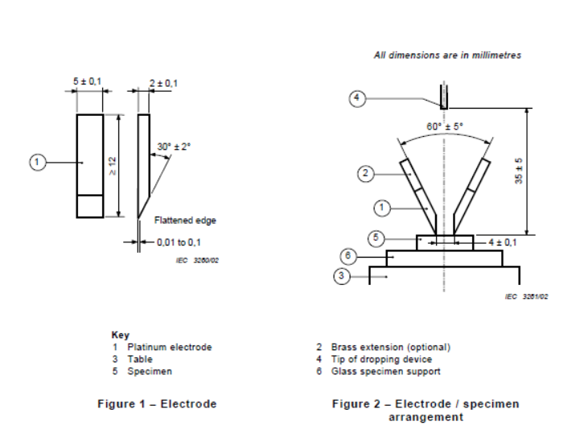
4) Annex N proof tracking test

Slide 38
4) Annex N proof tracking test
A thin metal rectangular slip gauge shall be used to check the electrode separation. The electrodes shall move freely and the force exerted by each electrode on the surface of the test specimen at the start of the test shall be 1,00 N ± 0,05 N. The design shall be such that the force can be expected to remain at the initial level during the test. (Force need to be verified)
One typical type of arrangement for applying the electrodes to the test specimen is shown in Figure 3. The force shall be verified at appropriate intervals.
Where tests are made solely on those materials where the degree of electrode penetration is small, the electrode force may be generated by the use of springs. However, gravity should be used to generate the force on general purpose equipment (see Figure 3).

Slide 39
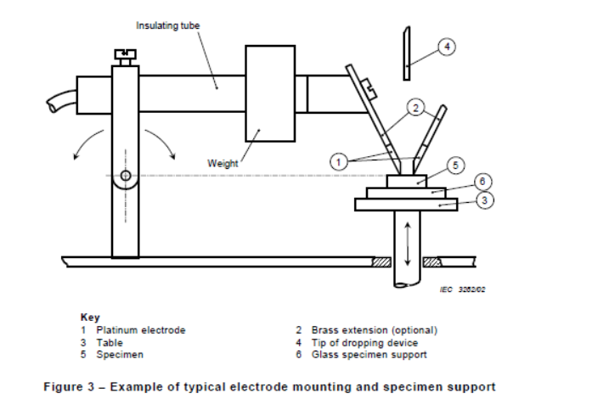
4) Annex N proof tracking test

Slide 40
4) Annex N proof tracking test
7.2 Test circuit
The electrodes shall be supplied with a substantially sinusoidal voltage, variable between 100 V and 600 V at a frequency of 48 Hz to 62 Hz. The voltage measuring device shall indicate a true r.m.s. value and shall have a maximum error of 1,5 %. The power of the source shall be not less than 0,6 kVA. An example of a suitable test circuit is shown in Figure 4.
A variable resistor shall be capable of adjusting the current between the short-circuited electrodes to (1,0 ± 0,1) A and the voltage indicated by the voltmeter shall not decrease by more than 10 % when this current flows (see Figure 4). The instrument used to measure the value of the short-circuit current shall have a maximum error of ±3 %. ( Use this value instead of OD-5014)
The input supply voltage to the apparatus shall be adequately stable.
The over-current device shall operate when a current with an r.m.s. value of 0,50 A with a relative tolerance of ±10 %, has persisted for 2,00 s with a relative tolerance of ±10 %. ( Use this value instead of OD-5014)

Slide 41
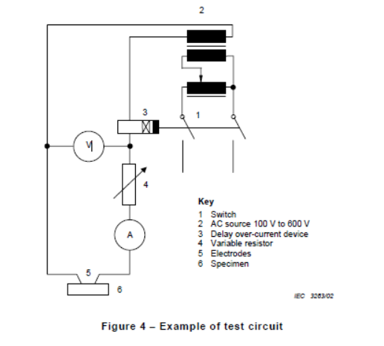
4) Annex N proof tracking test

Slide 42
4) Annex N proof tracking test
7.3 Test solutions
Solution A:
Dissolve approximately 0,1 % by mass of analytical reagent grade anhydrous ammonium chloride (NH4Cl), of a purity of not less than 99,8 %, in de-ionized water, having a conductivity of not greater than 1 mS/m to give a resistivity of (3,95 ± 0,05) Ωm at (23 ± 1) °C.
(Purchasing records of NH4Cl and deionized water are required. The measurement for the resistivity of solution is required, but the solution 0.1% is not required for verification)
Solution B: ( Not allowed)

Slide 43
4) Annex N proof tracking test
7.4 Dropping device
Drops of the test solution shall fall on to the specimen surface at intervals of 30 s ± 5 s. The drops shall fall more or less centrally between the electrodes from a height of 35 mm ± 5 mm.
The time for 50 drops to fall on to the specimen shall be (24,5 ± 2) min.
The mass of a sequence of 50 drops shall lie between 0,997 g and 1,147 g.
The mass of a sequence of 20 drops shall lie between 0,380 g and 0,480 g.
The mass of the drops shall be checked at appropriate time intervals.
(verification records are required for the mass of drops and the intervals)

Slide 44
4) Annex N proof tracking test
7.5 Test specimen support platform
A glass plate or plates, having a total thickness of not less than 4 mm and of a suitable size shall be used to support the test specimen during the test.
disposable glass microscope slide be placed on the specimen support table immediately under the test specimen.
7.6 Electrode assembly installation
The specimen and its immediate electrodes shall be mounted in an essentially draught-free space in an enclosure.
A suitable fume extraction system shall be provided to allow safe venting of the enclosure after the test.

Slide 45
4) Annex N proof tracking test
8 Basic test procedure
8.1 General
Where the material is substantially anisotropic, tests shall be made in the direction of the features and orthogonal to them. Results from the direction giving the lower values shall be used, unless otherwise specified.
Test shall be made at an ambient temperature of (23 ± 5) °C.
Tests shall be made on uncontaminated test specimens, unless otherwise specified.
The result of a test where a hole is formed is considered to be valid, irrespective of the test specimen thickness, but the formation of the hole shall be reported together with the depth of the hole (the thickness of the test specimen or stack).

Slide 46
4) Annex N proof tracking test
8.2 Preparation
After each test, clean the electrodes with an appropriate solvent and then rinse them with deionized water. If necessary, restore their shape and give a final rinse before the next test.
Immediately before the test ensure, if necessary by cooling the electrodes, that their temperature is sufficiently low so that they have no adverse effect on the specimen properties.
Ensure freedom from visual contamination and ensure that the solution to be used conforms to the conductivity requirements either by regular testing, or by measurement immediately before the test.
In case of dispute, the cleaning procedures used for the electrodes and dropper tube shall be agreed between purchaser and supplier.

Slide 47
4) Annex N proof tracking test
8.2 Preparation
Place the test specimen, with the test surface uppermost and horizontal on the specimen support table. Adjust the relative height of the test specimen and electrode mounting assembly, such that on lowering the electrodes on to the specimen, the correct orientation is achieved with a separation of 4,0 mm ± 0,1 mm. Ensure that the chisel edges make contact with the surface of the specimen with the required force and over their full width.
Set the test voltage to the required value which shall be an integer multiple of 25 V, and adjust the circuit parameters so that the short-circuit current is within the permitted tolerance.

Slide 48
4) Annex N proof tracking test
8.3 Test procedure
Start the dropping system so that drops fall on to the test surface and continue the test until one of the following occurs:
a) the over-current device operates;
b) a persistent flame occurs;
c) at least 25 s have elapsed after the fiftieth (hundredth) drop has fallen without a) or b) occurring.
After completion of the test, vent the chamber of noxious fumes and remove the test specimen.

Slide 49
4) Annex N proof tracking test
10 Determination of proof tracking index (PTI)
10.1 Procedure
Where, in IEC standards for material or for electrical equipment specifications, or in other standards, a proof test only is required, 50 drop tests shall be made in accordance with Clause 8 but at the single voltage specified. The required number of specimens shall withstand the test period up to at least 25 s after the fiftieth drop has fallen without tracking failure, and without a persistent flame occurring.
Operation of the over-current device by air arcs does not constitute a tracking failure.
The proof voltage shall be an integer multiple of 25 V.
Modification per IEC 60335-1:2010+AMD1:2013 +AMD2:2016, Annex N:
The proof voltage is 100 V, 175 V, 400 V or 600 V, as appropriate.
The test is carried out on five specimens.
In case of doubt, a material is considered to have a PTI of the specified value if it withstands the test at a voltage equal to the proof voltage reduced by 25 V, the number of drops being increased to 100.

Slide 50
4) Annex N proof tracking test
Equipment:
Check Calibration Records:
Calipers (up to 1 mm: ± 0,05 mm; 1 mm up to 25 mm: ± 0,1 mm; 25 mm and above: ± 0,5%)
Temperature Indicator ( +/- 2 degree C)
Humidity Meter (+/- 6%)
Force Meter (+/- 6%)
Voltage Meter ( +/- 1.5%)
Frequency Meter (+/- 0.2%)
Current Meter (±3 %)
Water Resistance Meter (+/- 5%)
Timer (+/- 1%)
Scale (+/- 1%)
Check Calibration or Verification Records:
Electrodes (Figure 1 and Figure 2 and Material purity) and Force on the material (1,00 N ± 0,05 N)
Test Circuit and over-current device (See page 40 for details)
Test Solutions ( See Page 42 for details)
Dropping devices ( See Page 43 for details)

Slide 51
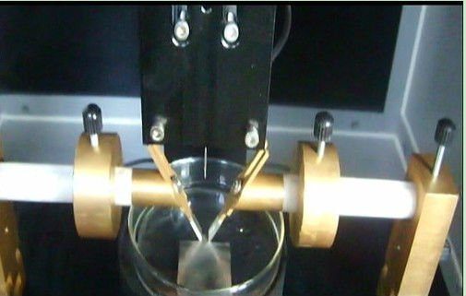
4) Annex N proof tracking test

Slide 52

Records of Audit
00-QA-F0407, V3.0 is used to record the audit results.
Audit Report Number |  | Page # | of
Facility/Lab Audited |  | Test Audit Plan Rev | 7.0
Auditor Name |  | Date
Test Field/Program | IECEE CB scheme

Slide 53
Revision History
1.0 Initial Release

